Slide 1
Risk
Concepts and management strategies

Slide 2
Contents
Risk Definition
Risk Profile
Financial Risk - types and evaluation
Tools and measures to control financial risk
Risk for Brokerage Firms - market and customers

Slide 3
Risk definition
Possibility that an outcome or investment's actual gains will differ from an expected outcome or return.
Includes the possibility of losing some or all of an original investment.
It measures the uncertainty that an investor is willing to take to realize a gain

Slide 4
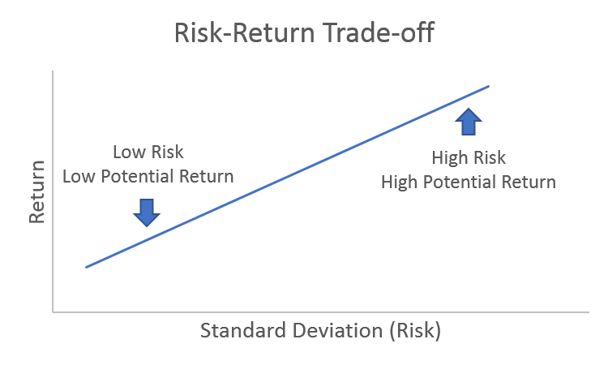
Risk vs. Reward
Risk return tradeoff is the balance between the desire for lowest possible risk and highest possible return.
Only a theoretical approach - high risk does not necessarily mean high return.
Consider expected return and volatility compared to the rate of return

Slide 5
Risk Profile
Risk profile identifies the level of risk an individual is willing and able to accept
Willingness to accept risk:
Risk-averse <-------> Risk-seeker
Low risk High risk
Low reward High reward
Ability to take risk: higher the assets and lower the liabilities
Willingness and ability to take risk may not align

Slide 6
How to identify Risk Profile?
Profile questionnaire - individual’s answers help to understand their risk tolerance
Risk register:
Illustrates risks and threats faced by an organization or individual.
Includes probability of negative outcomes and potential costs and disruptions
Possibility to proactively minimize risks

Slide 7
Risk = Financial Exposure
The amount an investor stands to lose should the investment fail
Gross exposure = sum of long and short positions
Gross exposure indicates the percentage of the fund’s assets that have been deployed and whether leverage (borrowed funds) have been used (if larger than 100%)
Net exposure = long - short positions

Slide 8
Types of Financial Risk
Risk can be systematic or unsystematic
Business Risk - viability of business, if the sales can cover all operational costs and generate profit
Credit or Default Risk - whether the borrower will be able to pay his debt obligations
Country Risk - if the country is not able to honor its financial commitments
Foreign-Exchange Risk - risk that changes in currency exchange rate will decrease the value of assets held in that currency
Interest rate risk - decreasing investment value due to changes in interest rates
Political Risk - effects of political instability or change in a country
Counterparty Risk - the other party of the transaction might default on its contractual obligation
Liquidity Risk - the ability to transact investment for cash

Slide 9
Systematic and unsystematic risk
Systematic risk - associated with the market, unpredictable and undiversifiable (e.g. political upheaval affects bond, stocks and currency markets).
Mitigated through hedging
Unsystematic risk- associated with company or sector, inherent to specific company or sector.
Mitigated through asset diversification

Slide 10
Risk Hedging
Hedge is an investment made with the intention of reducing the risk of adverse price movements in an asset
Eliminates risk by being inversely correlated to the vulnerable asset
Derivatives:
Options, swaps, futures and forward contracts
Comes at a price to reduce risk, decreases potential profits

Slide 11
Tools to control Financial Risk
Fundamental Analysis
- measuring intrinsic value by evaluating underlying business, assets and earning
Technical Analysis
- evaluating through statistics of historical values.
Quantitative Analysis
- evaluating historical performance using specific financial ratio

Slide 12
Risk Measures
Beta - systematic (market) risk measures volatility of an individual stock compared to the entire market
Money manager can attempt to increase the portfolio risk by taking on more market risk (beta greater than 1) or decrease by taking on beta less than 1
Alpha - is a measure of excess return
Active strategies include tactics that leverage stock, sector or country selection, fundamental analysis, position sizing, and technical analysis
R-squared - correlation between the investment and benchmark (percentage- 80-100% high correlation, lower than 70% low correlation)
Standard Deviation - data dispersion compared to mean value (volatility)

Slide 13
Risk Measures
Capital Asset Pricing Model - equilibrium theory based on relationship between risk and expected return
Efficient Frontiers - optimal level of diversification and asset allocation given the intrinsic risks of a portfolio
Sharpe Ratio - measures performance as adjusted to the associated risk (adjusted rate of return divided by st. deviation)
Sortino Ratio - removes the effects of upward price movements
Treynor Ratio - uses beta (correlation) with the portfolio

Slide 14
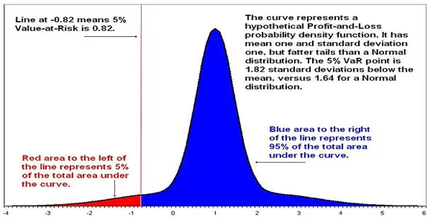
Risk Measures
Value at Risk (VaR) - the maximum potential loss with a degree of confidence for a specific period

Slide 15
Risk for Brokerage Firms
Sources of risk in the Brokerage Business:
Internal (failing to gain expected market share, compliance risks, credit risks)
Competition risks (banks, other security traders, copied innovations, constraints on innovation)
Loss of a favorable business environment (macroeconomic changes)

Slide 16
Risk Assessment of Customers
nature of the customer (e.g., institutional or retail) and its corresponding level of experience and sophistication
creditworthiness of the customer, as measured by established credit policies and procedures of the broker/intermediary
authority (including apparent authority) of the customer to conduct its proposed trading activities, including the customer's legal authority and the capacity of the individuals responsible for the trading.

Slide 17
Management of customer risk
Establishing margin requirements and position limits at adequate levels
Reviewing significant market exposures at least daily
Calling for additional collateral modifying margin requirements or position limits, reducing position size
Identifying and protecting customer property in their custody
Identifying cheating and arbitrage trading

Slide 18
References
Risk Management For Broker-Dealers By Alan M. Wolper https://www.lockelord.com/-/media/files/newsandevents/news/2008/08/practical-compliance--risk-management-for-the-se__/files/wolper-risk-management/fileattachment/wolper_pcrm_03-08.pdf
RISK MANAGEMENT AND CONTROL GUIDANCE FOR SECURITIES FIRMS AND THEIR SUPERVISORS https://www.iosco.org/library/pubdocs/pdf/IOSCOPD78.pdf
A comprehensive review of value at risk methodologies https://www.elsevier.es/en-revista-the-spanish-review-financial-economics-332-articulo-a-comprehensive-review-value-at-S217312681300017X
This wealth-tech startup helps Indians invest in Google, Amazon, Facebook, and other US stocks https://yourstory.com/2020/07/wealth-tech-startup-invest-google-amazon-facebook-usa-stocks
Securities and risk http://www.versobank.com/description-of-securities-and-risks-related-to-securities-eng.pdf
One of the disruptive factors that brokerages face these days is an increasing number of advanced traders who know how to outpace their brokerage and create toxic order flow. Arbitrage trading is a very modern trend, and we have skills in this area https://financefeeds.com/whats-the-cost-fx-dealing-desks-are-outmoded-full-report-from-moscow/

